Slide 2
Frame Relay
Frame Relay is a simplified form of Packet Switching, similar in principle to X.25
“Newer” form and quicker because of the error checking process - end nodes do the work
Synchronous frames of data are routed to different destinations depending on header information
Frames are variable length as opposed to fixed length with ATM – a picture of the frame layout is on the slide after the next

Slide 3
Asynchronous Transfer Mode (ATM)
ATM has the features required by public utility suppliers and therefore interests us
High speed, massive flexibility, efficiency as a carrier network, partitioning of bandwidth, and controllability
Normal implementation is high-performance ATM switches connected to high capacity trunk
(typically optical fibre as the cable medium) such as Synchronous optical network (SONET)
The carrier will provide smaller ATM switches for the interfaces to user networks

Slide 4
The basics of ATM
ATM uses a technique known as cell switching
Combines the benefits of circuit switching (guarantee capacity and constant delay) and packet switching (flexibility and efficiency for traffic relay)
ATM is connection orientated
Good QoS
Empty cells are used if no data is to be sent – Asynchronously

Slide 5
The basics of ATM
Operate the first two layers of OSI model
Complex configuration
Specially design for optical fibre or high performance cable - Laying cable requires road works – expensive
ATM devices – expensive

Slide 6
ATM Devices
ATM networks consist of ATM switches and ATM endpoints.
ATM switches accept the incoming cell from ATM endpoints or other ATM switches.
Switches read and updates the header information and forward the cell to output interface toward its destination
ATM endpoints contain ATM network interface adapter such as workstations, router, LAN switches

Slide 7
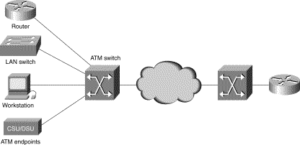
ATM Devices

Slide 8
ATM Cells (Packets)
Header
payload
5
48
53 octet fixed packet size
48-octet payload (information) field, and a 5-octet header
Header consists of routing and other necessary information
Cells relating to different traffic types are statistically multiplexed; random time interval between successive packets (hence asynchronous)
Small packet (cell) size has benefits – good for voice and video

Slide 9
The Cell Header
The cell header is used to carry a label
The label represents an address
Using different labels for each connection a large number of simultaneous connection to different remote terminals can be supported

Slide 10
ATM Topology
ATM LANs utilise a mesh topology, based on interconnected switching exchanges
Key elements are, therefore, the network interface and the ATM switch
ATM switch:
number of ports
provide a high bit rate switched communication path between those ports
routing task is a matter of identifying the paths between switch ports
Communications path is established prior to use (this is a connection orientated system)
All cells relating to the communication thereafter follow the same path

Slide 11
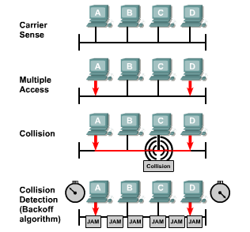
Ethernet
Carrier Sense Multiple Access/Collision Detect (CSMA/CD)
Access method CSMA/CD
Listen-before-transmit mode
If the network busy, the node will wait a random amount of time before retrying
If the network not busy, the node will begin transmitting and listening – Ensure not other node is sending data

Slide 12
Gigabit Ethernet
Built on top of existing Ethernet Protocols
Operates at Layer 1 and 2 of the OSI model
Similar format as is used for 10 and 100-Mbps Ethernet
Transmission using both fibre optic and copper media (UTP cable)
Great demands from servers – Traditionally add more servers on servers bottleneck but now can increase the performance of the server instead. i.e. Blade server from IBM or Dell

Slide 13
Ethernet Timing (Half Duplex mode)
Minimum packet size of 64 bytes to be capable of detecting a collision at the further end of the cable.
Detect collisions only turn on when it is in the transmit mode
The minimum size is specified to guarantee the sender remains in transmit mode, and therefore detecting collisions, long enough for a collision to propagate back to it from the farthest point on the wire from it.

Slide 14
Benefits of Gigabit Ethernet
Can use Optical fibre cable
Noise immunity
No grounding potential problems
Excellent distance characteristics
Can be used to connect widely dispersed Fast Ethernet (100Base or 10Base T)
Low cost of acquisition and ownership

Slide 15
Benefits of Gigabit Ethernet
IEEE 802.3a
Operates in half or full duplex mode
Q: why half duplex still being used?
Only functions over optical fibre at the moment
Maximum distance could reach up to 40KM over “dark fibre” (leased fibre)
Depends on single mode or multimode fibre
Still developing over copper cabling i.e. Cat 6 and Cat 7
Running 10Gigabit over copper at cutting edge
Q: – why use copper?

Slide 16
QoS Ethernet
Ethernet provides “best effort” data delivery
When demands exceed capacity, delay occurs and cause problems to real-time applications
Ability to prioritise data traffic for transmission
QoS not integrated in Ethernet Protocol

